Slide 1

Welcome!
This is a report that accompanies the dashboard I made.
The project is an HR data analysis of a dataset provided by a prominent travel agency, known as Green Destinations. It is suffering from high attrition rate.
The goal of the project is to help GD’s management gain a bigger understanding on the phenomenon, why it’s happening, how bad it is, and how to remedy it.
Green Destinations HR analysis

Slide 2
Contents:
Taking a general look at the company’s demographics, employee distributions by age, salary, tenure and more.
Highlighting different factors like travel requirements, overtime, commute distance, and job satisfaction, and visualizing their impact.
Proposing different recommendations and suggestions to help come up with effective strategies to curb attrition, and adjust any practices that are harmful to employee retention.

Slide 3
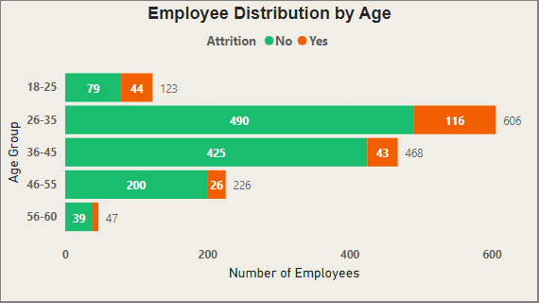
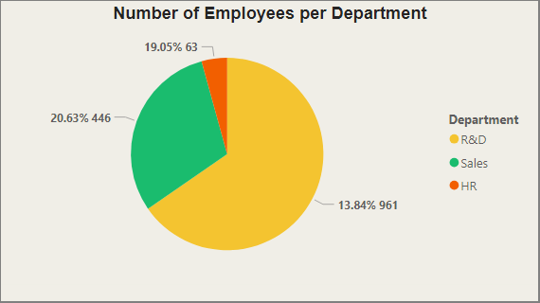
Employees in the 26-31 age bracket are the most common, and also contribute the most attrition. Much higher than the rest of the brackets.
Research & Development department has the most employees and suffers from proportionally the biggest attrition rate at 13.84% of 961 employees.
People aged 26-35 are often new parents and require better benefits and care than people in other age brackets, it might be worth offer better paternity benefits like leave and bonuses.
The suggestion would be to take a look at the R&D department and look for ways to improve employee life within it.

Slide 4
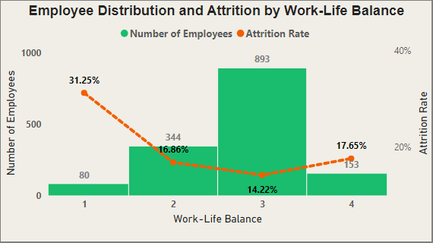
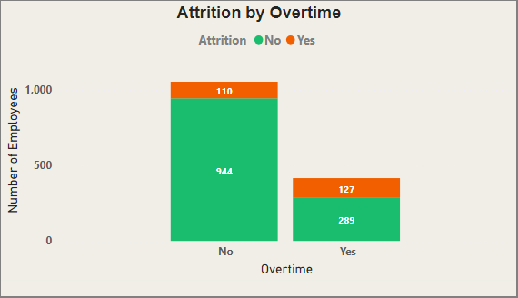
Proportionally, the attrition in employees that do overtime is large, but it doesn’t seem to be much bigger than with those that don’t.
Attrition and work-life balance go hand in hand, we notice a decrease in attrition rate in employees that are more satisfied with their work-life balance, even in higher samples.
It’s not a huge factor, but if management wants to lower attrition in employees that do overtime, and maybe make it more attractive to those that don’t, an increase in overtime compensation would go a long way.
Current average work-life balance is 2.73, with the biggest sample at 3 out of 4, so it’s not bad, but a way to improve would be to offer more flexible working hours, hybrid working conditions, and acquiring better mental health awareness.

Slide 5
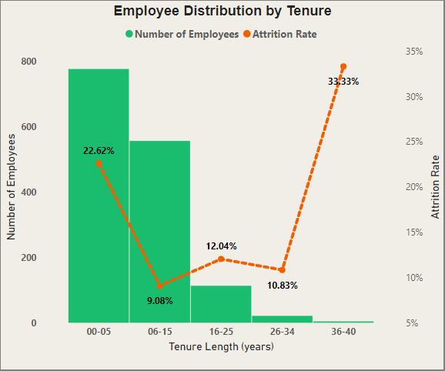
There is massive attrition among employees within their first five years in the company, at 22.62% of 776 employees.
People leaving during the first five years of their tenure might be up to a few reasons:
Poor onboarding: The onboarding process and mentorship may be in need of an overhaul, and emphasizing the role of senior employees.
Lack of growth opportunities: As it may be taking the employees too long to get promoted, or their improvement trajectory seems vague. I would offer new hires a clear career path and possibly a roadmap.
Entry level salary may be below expectations, so employees may just be using the positions to escape the entry level position, and move on to GREENER Destinations . A re-evaluation of entry level salary and benefits may be the best way to go forward here.

Slide 6
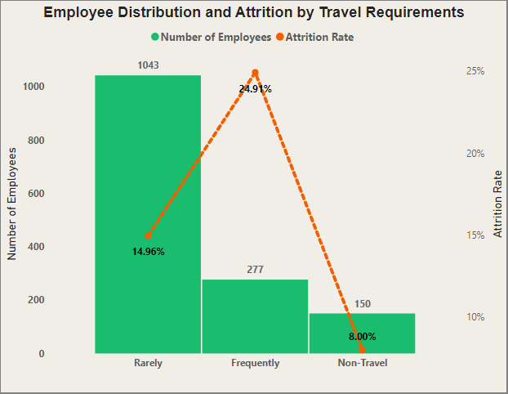
There is a significant increase in attrition in employees that travel compared to those that don’t, rarely or frequently.
Employee seem to be dissatisfied with travel assignments, as attrition in employees that travel is quite high, especially frequent ones:
Improving the travelling packages, like providing travel allowance to employees, paid meals, etc.
Adjusting travelling requirements, as well as allowing ample time between trips to allow the employees to manage stress and travel fatigue.
Conducting rigorous studies on travel reasons, to cut travel time as much as possible, and avoid unnecessary costs.

Slide 7
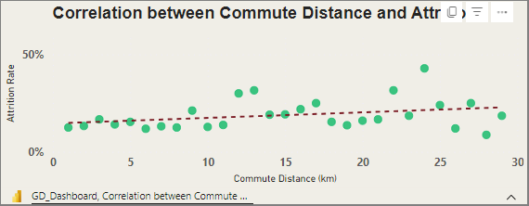
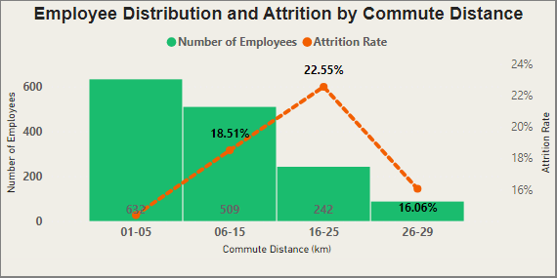
There is positive correlation between attrition and commute distance, attrition gets worse as the distance gets longer.
Commute Distance is a large factor in employee attrition, here are some ways to help:
Providing more hybrid and remote work opportunities, this would help the work-life balance as well.
Helping employees with public transportation costs.
Offering relocation packages to employees.
Making the office more attractive by adding some amenities like a gym or canteen.

Slide 8
General Recommendations:
Assuring the employees that the company is dedicated to improving the situation in Green Destinations, and showing willingness to address any complaints.
Improving communication between management and employees and taking complaints into consideration.
Conducting exit interviews for the employees that leave the company, and asking for their feedback.

Slide 9
Conclusion:
The fact that you are here today, and trying to work on the attrition in our beloved company, shows that you’re willing to improve it and that increases my faith in Green Destinations massively.
Hopefully, with our findings and recommendations, we’ll be able to reduce attrition in GD, and come back stronger than ever!
Thank you for your time and attention!

